Slide 1

Stroke prediction
Abhijith Anil Vamadev

Slide 2
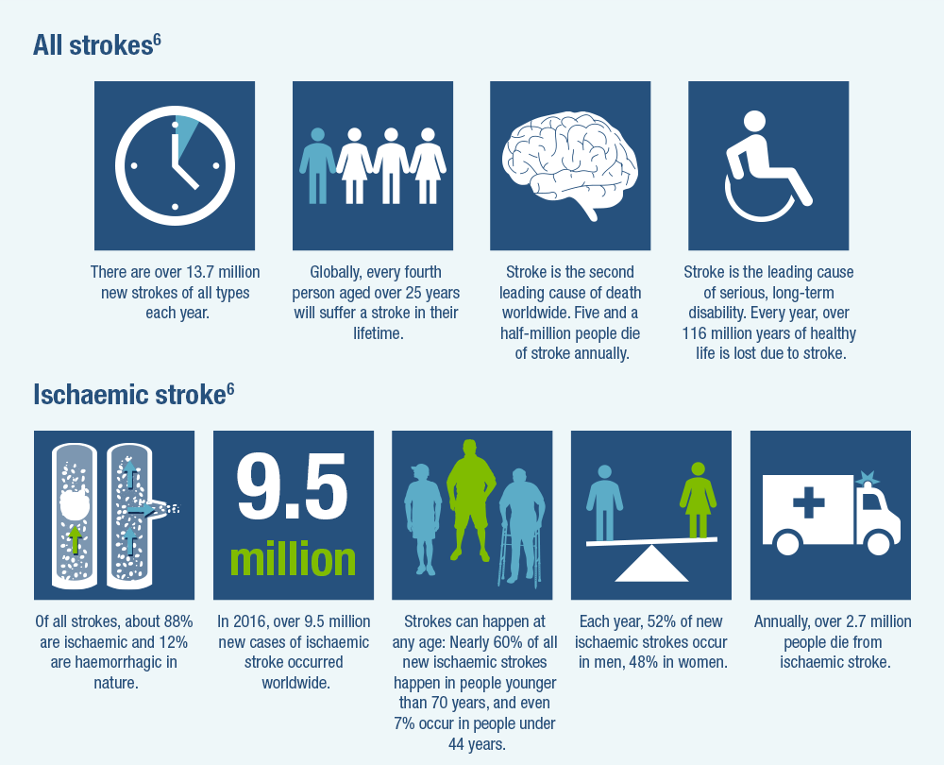
Why is it important?
Every 40 seconds, someone in the United States has a stroke
Patients who arrive at the ER within 3 hours of their symptoms are less likely to exhibit disability post stroke
High blood pressure, high cholesterol, smoking habits, obesity are all risk factors

Slide 3
Data Set
12 columns of data, 5110 rows of data
Target Variable – Stroke – Binary Classification variable
Variables:
ID – id of the patient
Gender – gender of the patient
Age – age of the patient
Hypertension – if the patient has hypertension
Heart Disease – heart disease patient or not
Ever Married – married or not
Work Type – work type
Residence Type – residence type
Avg_glucose – glucose level of patient
BMI – Body Mass Index of patient
Smoking Status – whether patient smokes or not.

Slide 4
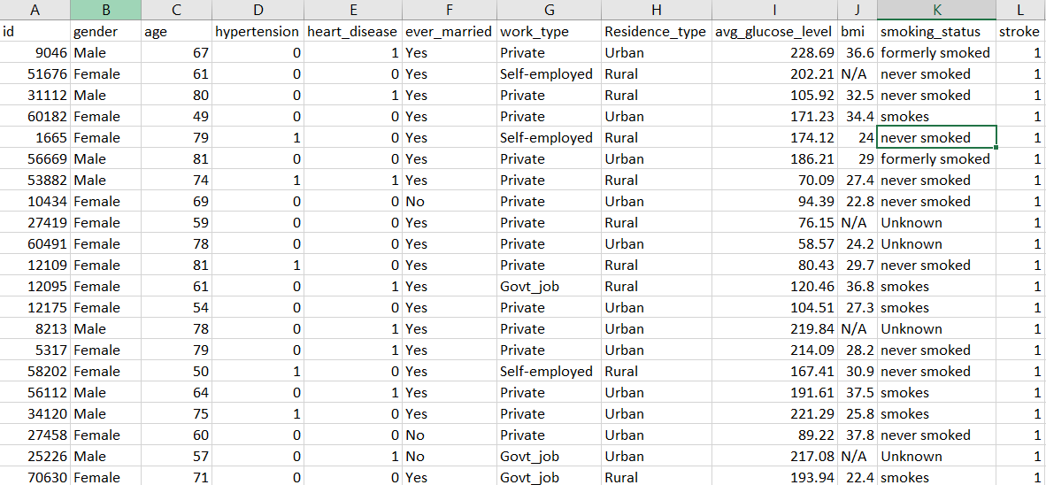

Slide 5
Data preparation before modelling
Some variables have null values, which needs to be accounted for.
Impute values
Outlier detection
Transformation of variables if needed
Exploratory Data Analysis
Balancing of data set – Currently highly imbalanced data set

Slide 6
Model evaluation
Recall will be used as the primary reference when comparing models, alongside accuracy.
Accurate classification and reasonable intervention for high-risk population can effectively reduce the burden of stroke on families and the society.
It is necessary to consider the recall of the classification model to ensure the pertinence of stroke intervention.
Logistic Regression
KNN
Decision Trees
Random Forests
SVM
Navies Bayes

